Slide 1
Vietnam War
Andrew Hodson

Slide 2
Description
The Vietnam War was a conflict in Southeast Asia.
It was part of the Cold War; conflicts over Communism and Capitalism.
It began in 1955 and went until 1975.
U.S. involvement begins to get serious in 1963.
58,222 American soldiers were killed, along with hundreds of thousands of Vietnamese.

Slide 3
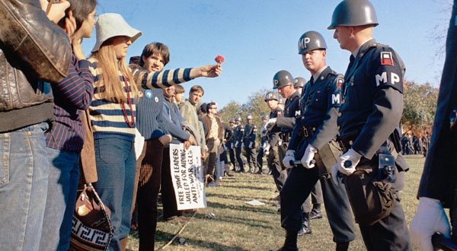
Primary Source

Slide 4
Description of the Primary Source
A photo from 1967.
Shows young ‘hippie’ woman giving flower to soldiers during an anti-Vietnam War protest.
The war was very unpopular with young people in America. Many were being drafted and forced to go to war.

Slide 5
Causes of the War
Communism, the idea that all capital (property) should be owned by the government and shared equally among the people, was growing in popularity in Asia.
The U.S., French, and other European countries saw this a threat to their system, called Capitalism.
This feud sparked rebellions and ultimately, the war.

Slide 6
Legacy of the War
The war was America’s first big military defeat in a long time.
Our enemies learned that guerilla tactics are effect against us.
It was responsible for starting the hippie movement.

Slide 7
Sources
https://en.wikipedia.org/wiki/Vietnam_War
https://en.wikipedia.org/wiki/Vietnam_War#/media/File:Vietnamdem.jpg

