Slide 1
Indianapolis Geography Project
By: Andrew Hodson

Slide 2
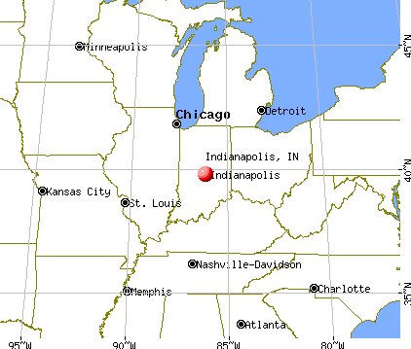
Indianapolis’ Location
39 Degrees North
87 Degrees West

Slide 3
Indianapolis’ Sense of Place
Physical Features
Culture
Very little change in altitude, very flat city
Humid continental climate; cold snowy winters, warm and humid summers
Predominately Christian, but more diverse than other cities around it
State capital, so lots of government workers
Bio-technology is a big part of the economy
Several large universities

Slide 4
Indianapolis’ Region
Indianapolis is in the Midwest Region.
This region has some of the following characteristics:
Industrial economies in cities
Farming economies in rural areas
Lower population density than other regions of the United States, like the Northeast, Southeast, or West Coast

Slide 5
Movement and Indianapolis
The movement of people in and around Indianapolis is primarily by personal vehicle. There is not much public transportation.
The movement of goods is big business in Indianapolis. We have a FedEx hub and lots of interstate truck traffic passes through the city.
The movement of ideas is through our universities, news outlets, and increasingly through social media/on-line sources.

Slide 6
Human-Environmental Interaction in Indianapolis
People effect the environment every day by using personal vehicles for transportation and burning coal for energy. Both have harmed the air quality.
People are effected by the environment every winter. There are often weather events that prevent people from going to work or school safely.

Slide 7
Sources
https://en.wikipedia.org/wiki/Indianapolis
http://www.city-data.com/city/Indianapolis-Indiana.html#b

